Slide 1

CAPSTONE PROJECT
TEAM NO: 71
Guide:
Dr B.Ramadevi

Slide 2

TEAM MEMBERS:
S.NO | NAME | ROLL NUMBER
1 | E. Harshitha | 2203A52210
2 | M. Srinitha | 2203A52201
3 | V. Lasya | 2203A52204
4 | M. Vishvaksena | 2203A52207
5 6 | K. Ranadheer Reddy B. Prason Paul | 2203A52153 2203A52240

Slide 3
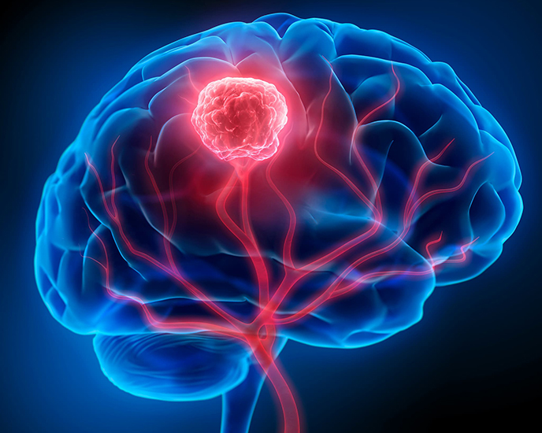
Brain Tumor MRI Image Classification with XAI

Slide 4
INTRODUCTION:
The brain tumors are severe neurological conditions that need proper and prompt diagnosis. The MRI method is the best imaging method used to determine the abnormalities in the brain yet manual diagnosis is time consuming and can be easily subject to human error.Deep Learning (DL) models such as CNNs are capable of automatically classifying the learners of brain tumors Glioma, Meningioma, Pituitary, and Healthy Brain with high accuracy. Nevertheless, these models tend to be black boxes whereby doctors are not able to trust their decisions.To address this, the project incorporates the Explainable Artificial Intelligence (XAI) algorithms like Grad-CAM and Integrated Gradients to enable the model to be transparent and intelligible in making predictions. This guarantees accuracy and clinical confidence to aid the radiologists in making sound decisions.

Slide 5
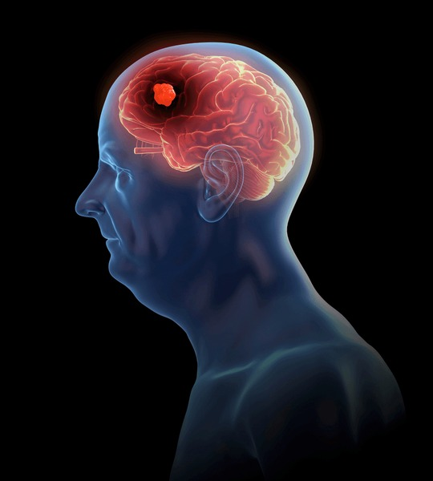
PROBLEM STATEMENT
The interpretation of MRI scans to reveal brain tumors is a manual process that is lengthy, labor intensive and is subject to diagnostic error as it is limited to human interpretation. Deep Learning models are black-box systems, which provide predictions without the rationale of how it was obtained although they are highly accurate at classifying MRI images. This is not very transparent, which restricts the clinically adopted use and confidence of radiologists. Thus, an Explainable AI (XAI)-based system that can not only properly classify brain tumors but also visualize and explain its decisions in a way that will facilitate safe and comprehensible medical diagnosis is needed.

Slide 6
OBJECTIVES & MOTIVATION
Objectives:
1. In order to create a Deep Learning model to differentiate between Glioma, Meningioma, Pituitary and Healthy Brain based on the brain MRI scans.
2. To incorporate Explainable AI (XAI) methods Grad-CAM and Integrated Gradients Transparency of a model.
3. To produce heatmaps that show regions of tumors that affect the prediction in the models.
4. In order to assess model performance in terms of Accuracy, Precision, Recall, F1-score, and ROC-AUC measures.
Motivation:
Timely and proper diagnosis of brain tumors is the key to successful treatment and survival of the patient. Old-fashioned diagnostic techniques are usually slow and subjective, whereas new Deep Learning solutions, despite being powerful in nature, are not interpretable. This project focuses on developing a system that is able to not only identify tumors effectively but also justify why it did it filling the gap between AI and clinical trust in the system.

Slide 7
PROPOSED SYSTEM OVERVIEW:
It locates brain MRI images of Glioma, Meningioma, Pituitary and Healthy Brain through the Deep Learning-based CNN model with the Explainable AI (XAI) techniques. Before MRI images are trained, normalization, resizing and augmentation are performed. The heatmaps produced with the help of Grad-CAM and Integrated Gradients are able to show the regions of the tumor that influence predictions, make the model more transparent, trustworthy, and clinically interpretable.

Slide 8
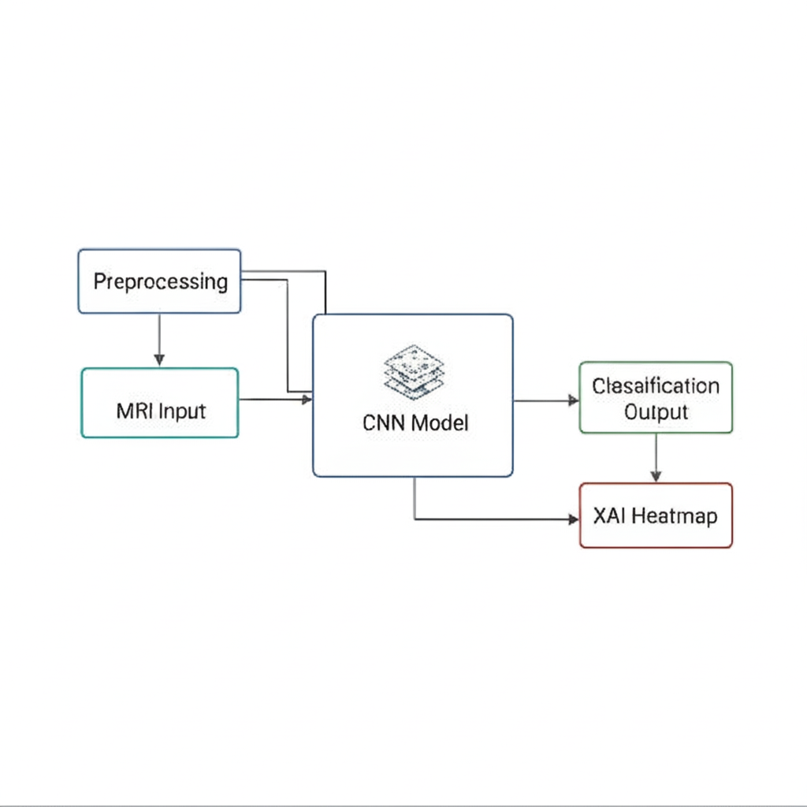
ARCHITECTURE
It presents brain MRI scans of Glioma, Meningioma, Pituitary and Healthy Brain using Deep Learning based CNN model as well as Explainable AI (XAI) techniques. MRI images are normalized, resized and augmented then trained. Heatmaps generated via Grad-CAM and Integrated Gradients are used to determine the tumor regions influencing predictions, improve the model transparency, trust as well as clinical interpretability.

Slide 9
KEY FEATURES
Automated Brain Tumor Detection: Predicts the type of MRI scan Glioma, Meningioma, Pituitary and Healthy Brain with a CNN-based model.
Explainable AI Integration: It is known with the help of Grad-CAM and Integrated Gradient to generate heatmaps of places in the tumor that influence predictions.
High Accuracy & Reliability: It has good classification and good performance in evaluation parameters.
Clinically Interpretable Results: Visual Explanations to enhance trust and transparency in AI-aid including the diagnostic process.
Scalable Design: Can be expanded to 3D MRI analysis or can be put into use with hospital diagnostic systems.

Slide 10
CHALLENGES & SOLUTIONS
Challenges: Deep learning models used to classify medical images can be black boxes and thus it can be hard to explain the model and rely on prediction.
Solutions: Add Explainable AI (XAI) methods like Grad CAM and Integrated Gradients to give visual explanations (heatmaps) showing the parts of the model that affect the decision, which will enhance the level of transparency and clinical trust.

Slide 11
METHODOLOGY & RESULTS
Methodology:
MRI scans of brain tumor(Glioma, Meningioma, Pituitary, Healthy).
Normalize, upscale and resize images to enhance model- quality.
Training a CNN model to predict the type of four types of tumors that the MRI scan belongs to.Include XAI methods like Grad-CAM and Integrated Gradients to explain the models.
Prepare heatmaps that reveal tumor regions that were predicted.
Compare the performance of the model according to Accuracy, Precision, Recall, F1-score and ROC-AUC.
Results:
This system had the capability to differentiate brain MRI scan in Glioma, Meningioma, Pituitary and Healthy Brain. The Grad-CAM and Integrated Gradients XAI techniques gave heatmaps showing the regions of tumor that influenced the prediction. The model is correct and it has converged consistently which is a good performance. Introduction of XAI improved trust, interpretability, and clinical transparency in the diagnosis.

Slide 12
PROPOSED PLAN
It will entail the creation of an AI-based system that will be able to classify the images of brain MRI automatically based on the below classes: Glioma, Meningioma, Pituitary and Healthy Brain. This is initiated by gathering and processing MRI images and then training a CNN model that classifies tumors correctly. Grad-CAM and Integrated Gradients, are some of the Explainable AI (XAI) methods used to visualize the tumor regions that affect predictions to promote transparency and clinical trust. Lastly, the system will be tested based on general metrics such as Accuracy, Precision, Recall, F1-score, and ROC-AUC, and it is possible to consider it as a decision-support system used by radiologists in the real-life context.

Slide 13
FUTURE SCOPE
The system may be enhanced by incorporating bigger and more varied MRI datasets to enhance accuracy and generalization.
The next steps of work involve the creation of 3D deep learning models to perform volumetric tumor analysis and uncertainty estimation as a way to make reliable predictions.
The model can be implemented either as a web or mobile-based clinical decision-support tool, which will allow the real-time diagnosis.
Additionally, scalability and real-world applicability may be improved by integrating with hospital PACS systems and AI platforms that are based in clouds.

Slide 14
CONCLUSION
It shows an AI-based solution to predicting brain tumors based on the MRI scans with Deep Learning and Explainable AI (XAI) methods. The system detects MRI images with high accuracy in the classifications of Glioma, Meningioma, Pituitary and Healthy Brain and can show visual heatmaps in Grad-CAM and Integrated Gradients to describe its results. This accuracy and transparency promote clinical trust, reliability, and interpretability in the diagnosis that is assisted by AI. The created model can be viewed as a powerful base of healthcare AI systems in the future and add value to quicker, more dependable, and clarifiable medical decision-making.

Slide 15
—
THANK YOU

